Slide 1
STOCK MARKET PREDICTOR
BY
ENZO TECHOHOLICS-08

Slide 2




Meet the Team
SIVA SAI KRISHNA
KOUSHIK
PAVAN KUMAR
lokesh
9920004697
9920004712
9920004718
9920004651
Notes:
© Copyright Showeet.com – Creative & Free PowerPoint Templates

Slide 3




OBJECTIVE
YOU WILL GET TO KNOW BRIEFLY ABOUT WHAT IS STOCKS?
HOW MACHINE LEARNING WITH PYTHON CAN BE USED TO ANALYSE A STOCK
ABOUT THE ALGORITHM USED

Slide 4
MAIN MENU
INTRODUCTION
MACHINE LEARNING IN STOCK PREDICTION
USE CASE ALGORITHM
SIMULATION OUTPUTS
conclusion
DATA SET DESCRIPTION AND
DATA MODELS

Slide 5
LITERATURE SURVEY
S.NO | TITLE OF THE PROJECT | METHODOLOGY/TECHNIQUES | ADVANTAGES | DISADVANTAGES
1. | Stock Market Forecasting Using Machine Learning Algorithms | support vector machine (SVM) | SVM supports both linear and non-linear solutions using kernel trick. SVM handles outliers better than LR. | SVM algorithm is not suitable for large data sets
2. | Stock Market Forecasting Using Machine Learning Algorithms | reinforcement learning | Maximizes Performance. Sustain Change for a long period of time | It Only provides enough to meet up the minimum behavior.
3. | Predicting Stock Market Indicators Through Twitter “I hope it is not as bad as I fear” | Decision tree | Decision trees are able to handle both continuous and categorical variables. | Decision trees are less appropriate for estimation tasks where the goal is to predict the value of a continuous attribute.

Slide 6
S.NO | TITLE OF THE PROJECT | METHODOLOGY/TECHNIQUES | ADVANTAGES | DISADVANTAGES
4. | Analysis of stock market predictor variables using Linear Regression | Linear Regression | Linear Regression is simple to implement and easier to interpret the output coefficients. | On the other hand in linear regression technique outliers can have huge effects on the regression and boundaries are linear in this technique.
5. | Stock market predictor using prescriptive analytics | Decision making algorithm | Less data cleaning required. | Decision tree often involves higher time to train the model.

Slide 7
01
INTRODUCTION Lokesh

Slide 8
Lets understand briefly about the stock
A stock (also known as equity) is a security that represents the ownership of a fraction of a corporation.
Corporations issue (sell) stock to raise funds to operate or develop their businesses.
Buyers starts buying and selling as their wish on the working days in the market.

Slide 9
All stocks move up and down over time, creating temporary "highs" and "lows." When a stock creates a sequence of "higher highs and higher lows," it is trending.
The stock market is influenced by many factors as economic, condition and traders expectations.

Slide 10
IS THIS ENOUGH ?
But as a trader we have to take the decisions alone right?
FOR THAT THE DECISION MUST BE CERTAIN,PROFITABLE TO US.
As to make that comfort being a tech guy what you can do?

Slide 11

As a responsible trader what we can do for good profits?

Slide 12


TECHNICAL ANALYSIS

Slide 13
02
MACHINE LEARNING IN . STOCK PREDICTION siva sai

Slide 14
THE FIELD OF MACHINE LEARNING IA VAST AND PLAYS A KEY ROLE IN WIDE RANGE OF CRITICAL APPLICATIONS. SUPERVISED LEARNING IS HELP FULL TO PREDICT THE STOCK OF THE COMPANY. WE USED REGRESSION MODEL IN THIS PROJECT. PREDICTING THE STOCK MARKET INVOLVES PREDICTING THE CLOSING PRICES OF A COMPANY`S STOCK FOR ANY GIVEN NUMBER OF DAYS AHEAD. IN OUR PROJECT NOT ONLY INCLUDES THE DOW THEORY. BT ALSO COMPRISES THE DOWN FALL(BEARISH) SO, LINEAR REGRESSION MODEL AND SVM(SUPPORT VECTOR MACHINE) ALGORTHIM USE TO PREDICT THE STOCK .

Slide 15

DATA
Financial markets are highly volatile and generate huge amount of data daily.
It is the most popular financial market niche and its value changes quickly.

Slide 16


Use case algorithm

Slide 17
SIMPLE LINEAR REGRESSION
Linear regression models are used to show (or predict) the relationship between two variables or factors.
The variable that the equation in your linear regression model is predicting is called the dependent variable. We call that one y. The variables that are being used to predict the dependent variable are called the independent variables. We call them X.
A linear regression line has an equation of the form
Y = a + bX
where X is the explanatory variable and Y is the dependent variable. The slope of the line is b, and a is the intercept (the value of y when x = 0).

Slide 18
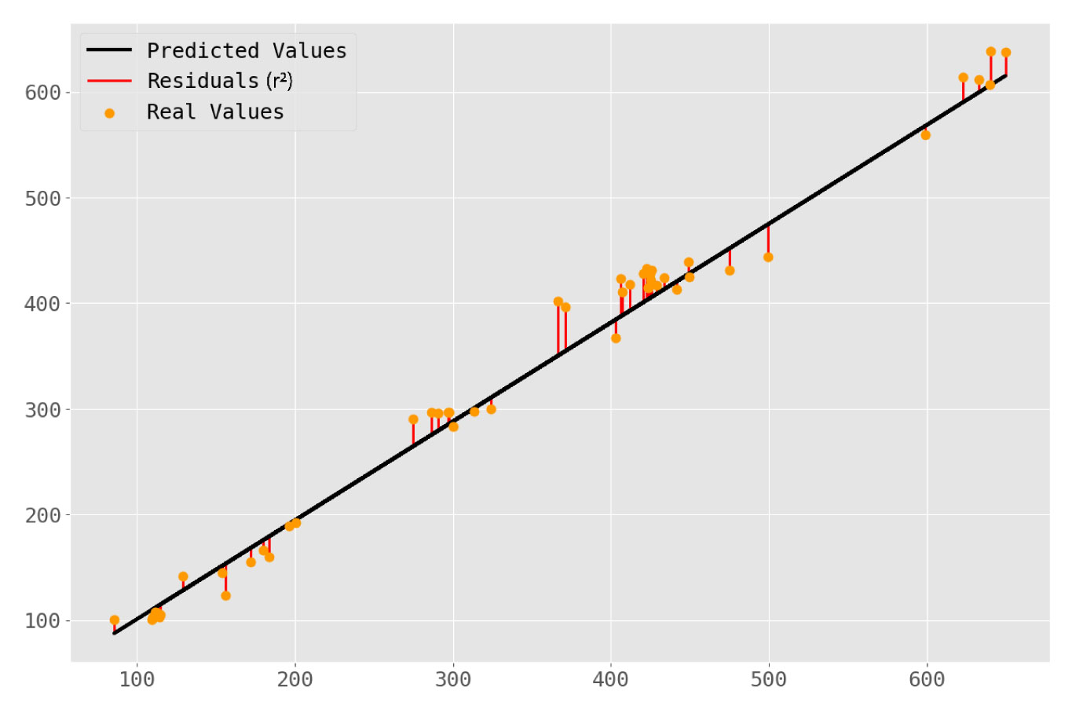
Y = a + bX

Slide 19
03
Data set description and data modeling koushik

Slide 20
DATA SET DESCRIPTION
THE DATA SET USED FOR THE ANALYSIS OF THE STOCKS IS OF HINDUSTAN UNILEVER’S 2020,2021, WHICH CONSIST OF
Open
High
Low
Close
Adj Close
Volume.
But we used only Adj Close and Date from the datasaet

Slide 21
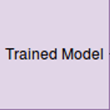
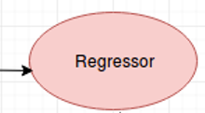
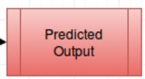
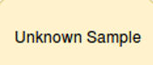


DATA MODEL

Slide 22
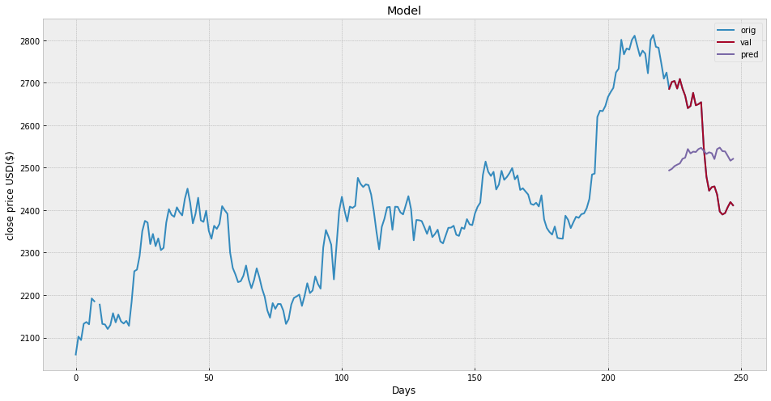
Simulation outputs

Slide 23
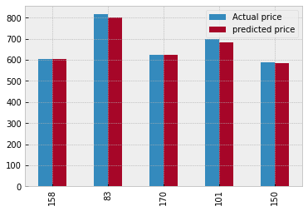

Slide 24
CONCLUSION
We have learned how to implement machine learning in stock prediction
Pridicting a stock using linear regression is a easy task.
Using Linear regression algorithm we can predict a stock accurately
But we don’t have to depend only on our model, to make some good profit we need to do other analysis.

Slide 25
STATUS OF THE PROJECT:
S.NO | PROJECT PHASES | STATUS
1. | Preprocessing | COMPLETED
2. | Implementation of Algorithm | COMPLETED
3. | Segmentation Process | COMPLETED
4. | Comparison with existing techniques | COMPLETED
5. | Classification Process | COMPLETED
6. | Output | COMPLETED

Slide 26
REFERENCES
G. E. P. Box and G. M. Jenkins, Time series analysis: forecasting and control. San Fransisco, CA: Holden- Day, 1976. to Bull and Bear Markets, President, Global Financial Data, Inc.
H.White, “Economic prediction using neural networks: the case of IBM daily stock returns,” In Proceedings of the second IEEE annual conference on neural networks., II, pp. 451– 458,1988.
Henry M. K. Mok, “Causality of interest rate, exchange rate and stock prices at stock market open and close in Hong Kong,” Asia Pacific Journal of Management, Vol. 10 (2), pp. 123– 143,1993.

Slide 27


THANK YOU!

